Slide 1
<SOLID Principle>
<Natnael TSige>
<MULUH CLIVE MULUH (*_*)>
<Nick scofield>

Slide 2

Background
SOLID principles are a set of object-oriented design principles collected by American computer Scantiest Robert C. Martin (aka uncle Bob) in 1995.
Martin has written many book.
Recommendation
“Design principles and patterns”(2000)

Slide 3
What is Solid principle?
The SOLID Principles are five principles of Object-Oriented class design.
SOLID is an acronym for the following five principles.
S - Single responsibility principle (SRS)
O - Open-Closed principle (OCP)
L - Liskov substitution principle (LSP)
I - Interface segregation principle (ISP)
D - Dependency inversion principle (DIP)

Slide 4
What are the goals of SOLId Principle?
To make program
Understandable
Flexible
Maintainable

Slide 5
Single Responsibility Principle (SRP)
Guiding principle for SRP is
A class should have one and only reason to change.
This means each class should have single responsibilities.
Emphasis on high cohesion and low coupling.

Slide 6
Why SPR?
Improves readability
Higher usability
Makes testing easier
Improves maintainability

Slide 7
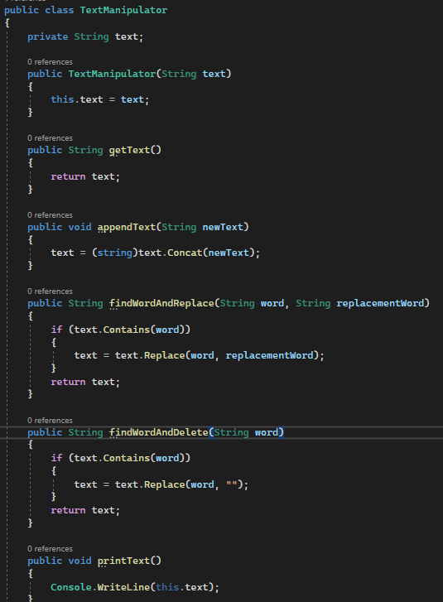
Violation of SRP
Where did this implementation violate the SRP?
How can the code be improved?

Slide 8
What problem have we noticed?
Two different responsibilities assigned to a single class.
Although this works just fine, it is not an ideal implementation.
Here we have two responsibilities: manipulating and printing the text
How might that be a problem?
Lack of cohesion
Makes modification more difficult

Slide 9
Solution
What changes can we make to the class to make sure that the class adheres to the single responsibility principle?
Decouple the manipulate and output logic.
What would be the benefit of decoupling the logics?
Easy to modify
Can expand the print logic further

Slide 10
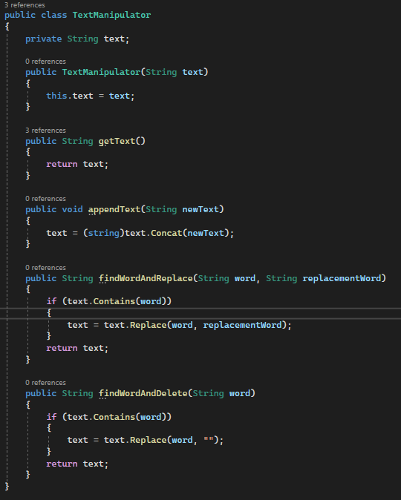
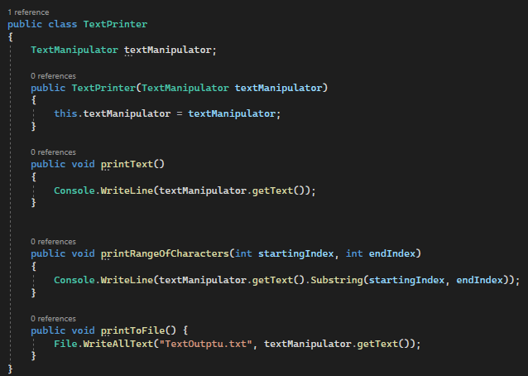
Proper implementation

Slide 11
Open-Closed principle (OCP)
Open-Closed principle states that:
A software entity such as class, modules and function should be open for extension but closed for modification.
Note: We should be able to add new functionality without touching the existing code for the class.
Why not modify existing Code?
This because modifying an existing code come with a risk of cratering bug.
How can we add functionality without modifying an existing class?
This is done with the use of interface and abstract class.

Slide 12
Why Open-Closed principle (OCP)?
Makes testing easier
Avoid creating a bug
Helps maintain SRP

Slide 13
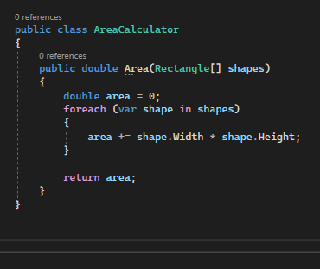
scenario
Amateur SOLUTON
Suppose we were asked to implement an application that returns the sum of the areas of multiple rectangle.
This implementation works fine. However, There is a room for improvement.

Slide 14
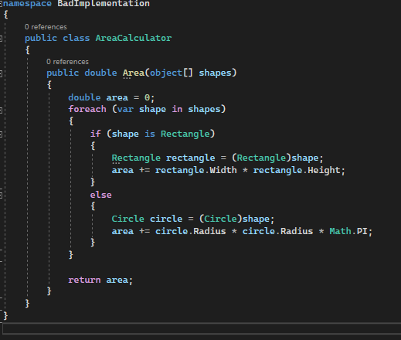
What if the requirement changed?
Suppose our client asked to us to make the program support other shapes too. I.e. A circle
We could add a conditional statement.
What is the problem with the following implementation?
As we account for many shapes, we would have an undesirable code with many conditional statement .

Slide 15
Open-closed principal violation
AreaCalculator isn’t closed for modification as we need to change it in order to extend it. Or in other words: it isn’t open for extension.
Makes the overall program difficult to maintain.
Makes testing difficult.
How to implement in accordance with Open-close principles?
Use interface or abstraction

Slide 16
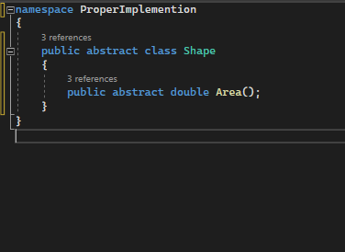
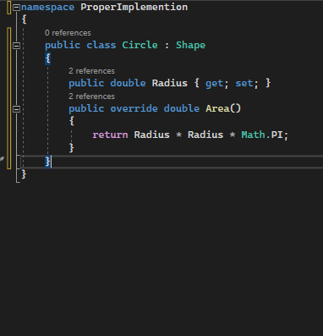
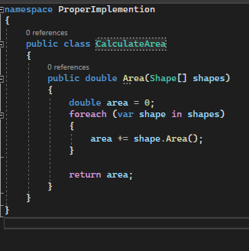
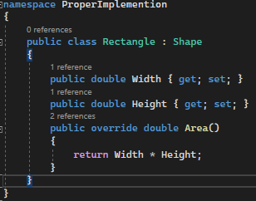
Proper implementation

Slide 17
Liskov substitution principle (LSP)
Liskov Substitution Principle states that subclasses should be substitutable for their base classes.
Given that class B is a subclass of class A, we should be able to pass an object of class B to any method that expects an object of class A and the method should function without any error.
This means a subclass should inherit all the characteristics of its parent class and never disregard or downsize any property of the parent class.

Slide 18
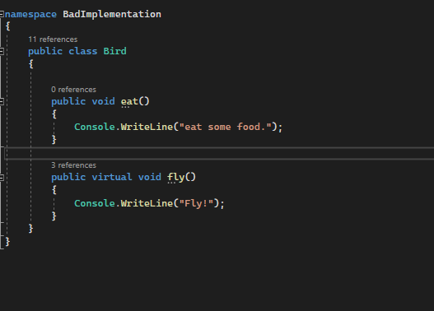
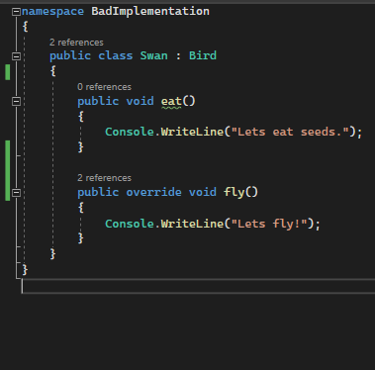
Example
Suppose we the following classes.

Slide 19
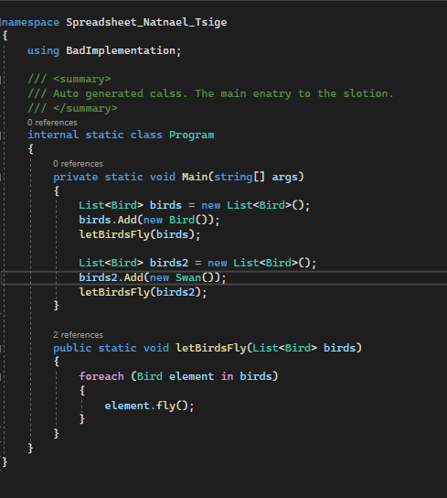
demo in which substitution works
Here our inheritance was successful
What will the output to this be?
Fly
Let's fly!
What if we wanted implement a bird that can’t fly. I.e., Penguin.

Slide 20
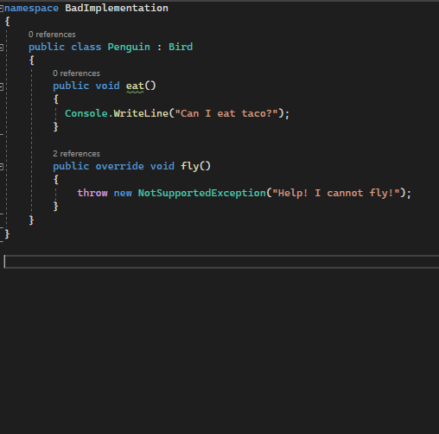
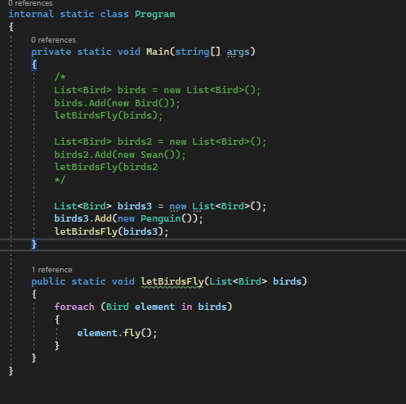
LSP example cont….

Slide 21
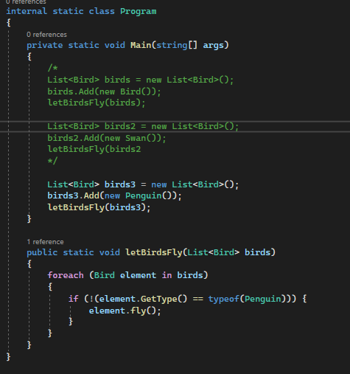
LSp Example Cont ….
What would the out be for the demo?
Because penguin can’t fly the demo will throw an exception.
Of course, we can fix this by filtering out birds that can’t fly, but it’s not ideal approach.
Why shouldn't we do that?

Slide 22
What problems do we observe?
The penguin class downsize the functionality of the bird class.
This is a direct violation of the LSP.
Functions that use pointers or references to base classes must be able to use objects of derived classes without knowing it.
It also breaks the open-closed principle
What if we added multiple birds that can not fly?
How we can we refactor the program so that we can avoid the misbehavior of non-flying birds?

Slide 23
In class exercise.
Refactor the program such that it operates in accordance with LSP.
Hint:
Think of the single responsibility rule.
Where do we have multiple responsibilities in a single class?
How would we decouple those responsibilities.

Slide 24
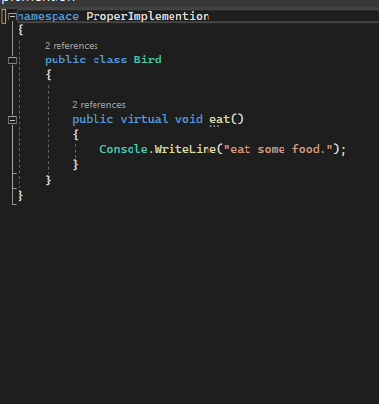
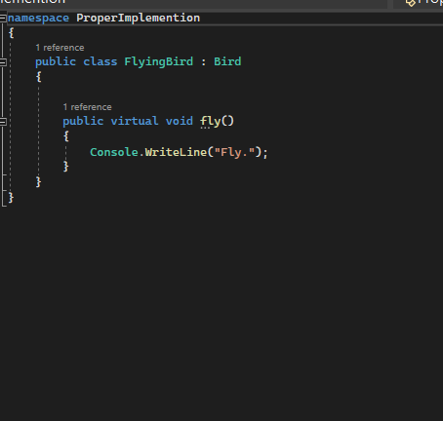
Solution

Slide 25
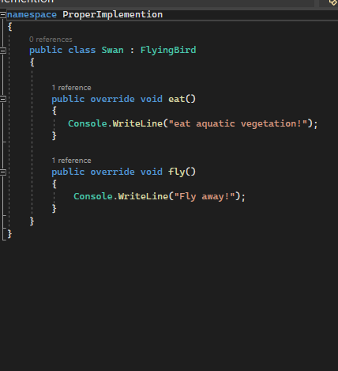
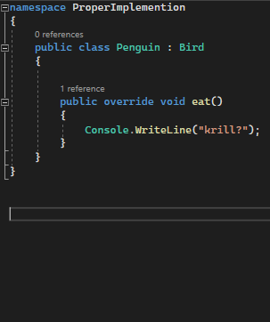
Solution Cont

Slide 26
Any question?

